Slide 1
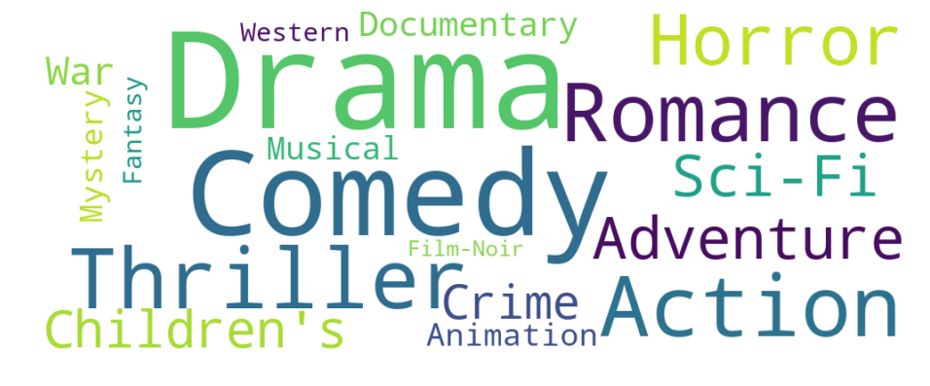
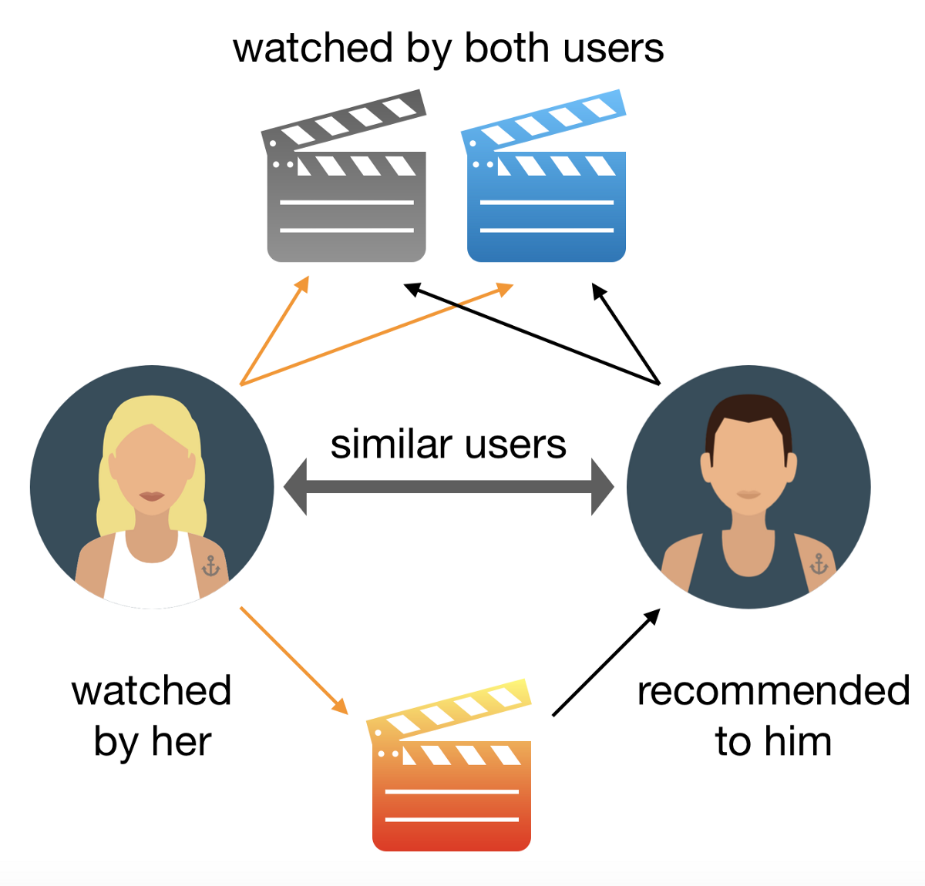
Capstone Project Presentation

Slide 2
Capstone Project : Problem Statement
Problem Statement>> Video watching Predication and Recommendation : Segment the audience of a content app based on its user’s propensity to watch a video in the next 2 days and recommend the users to watch the videos as per his / her taste.
Data Information: The data is related to the various event details for a Video Content app. As the user engages with the app, some of his actions are recorded in detail.
For eg. as soon as the user launches the app, an "AppLaunched" event is recorded which contains details such as timestamp, OS, device, country, userId etc.
When the user registers itself for the app, a "Registered" event is raised. Similarly when he views the details of a video or an episode, a "VideoDetails" event is recorded.
Also, when he starts watching a video, a "VideoStarted" event is raised.
App owners also engage with the customers via Push Notifications, SMS, emails etc. When a user clicks on any such campaign, a UTM Visited campaign is recorded.
Goal:- The goal is to classify the audience of a content app based on its user’s propensity to watch a video in the next 2 days and recommend the users to watch the videos as per his / her taste and previous history.

Slide 3
Data description
App Launched
Registered
Video Started
Video Details
UTM Visited
App Uninstalled

Slide 4
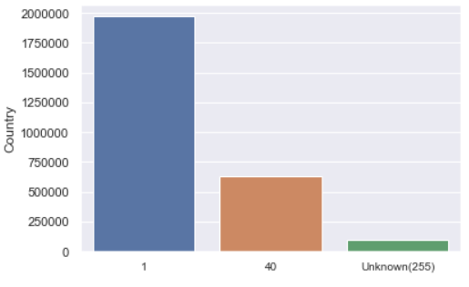
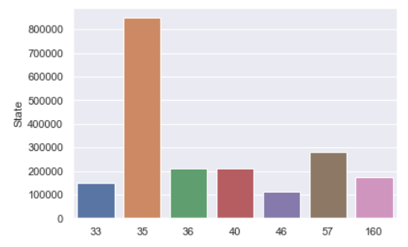
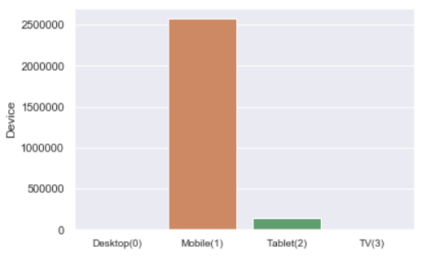
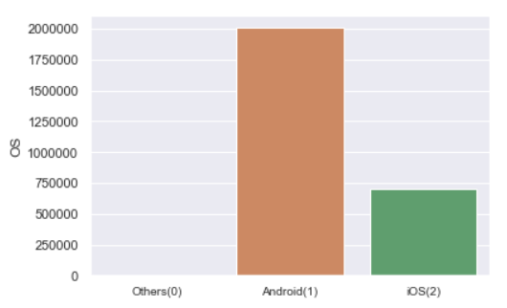
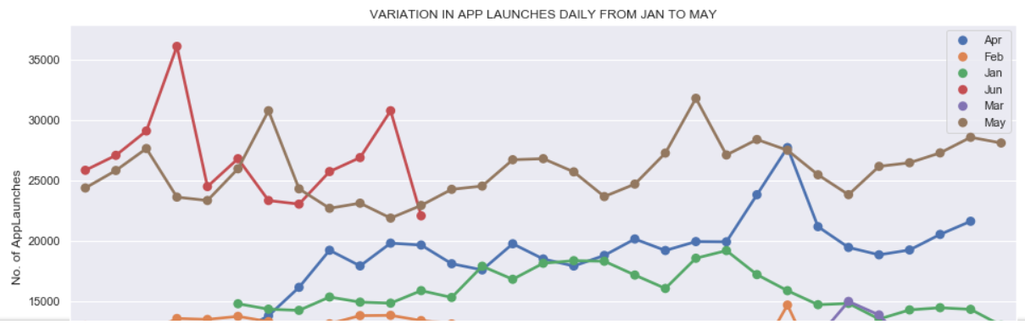
Data Exploration
AppLaunched (Distribution Graphs)

Slide 5
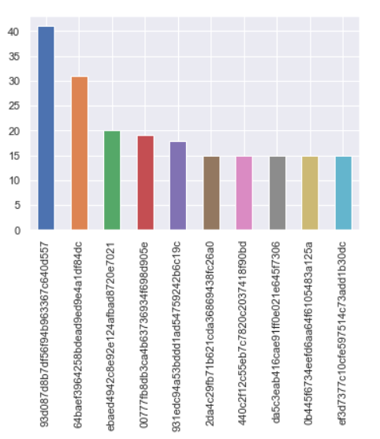
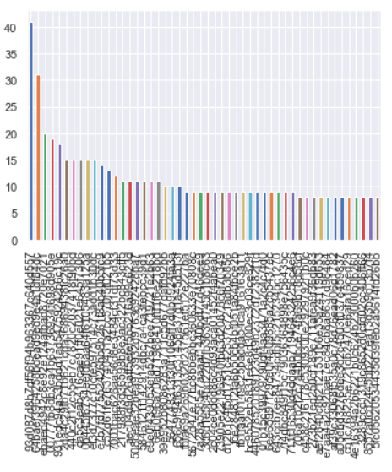
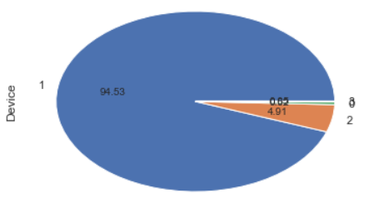
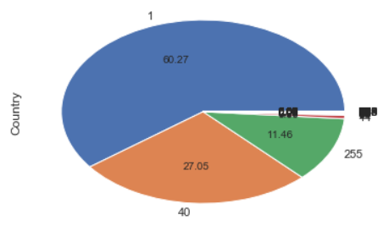
Data Exploration
AppUninstalled (Distribution Graphs)

Slide 6
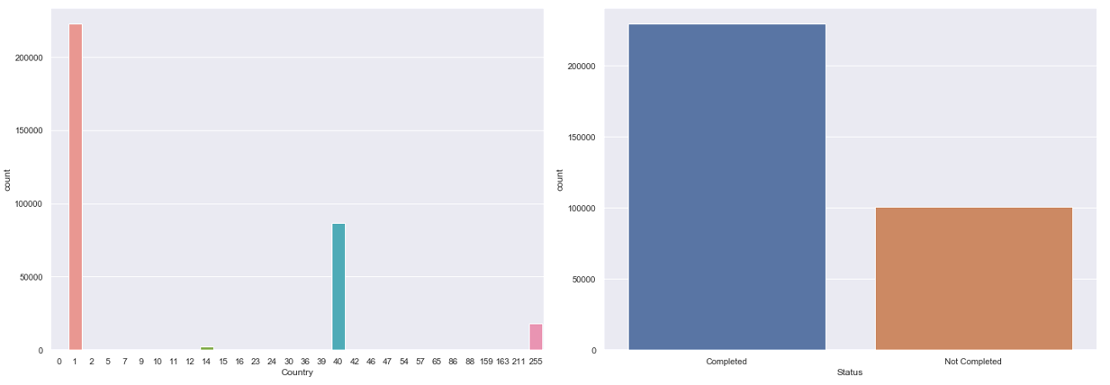
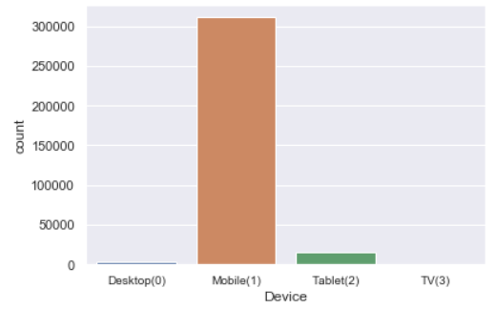
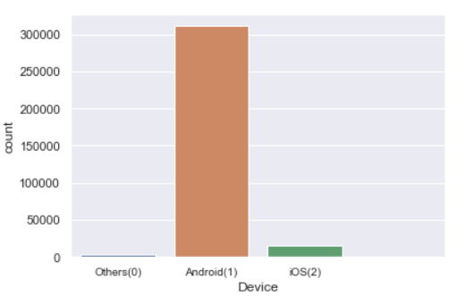
Data Exploration
Registration (Distribution Graphs)

Slide 7
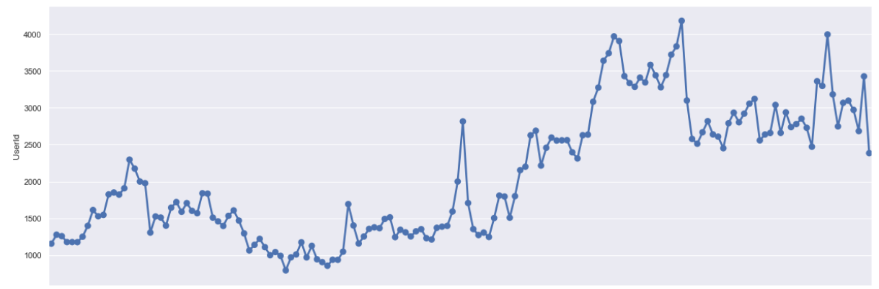
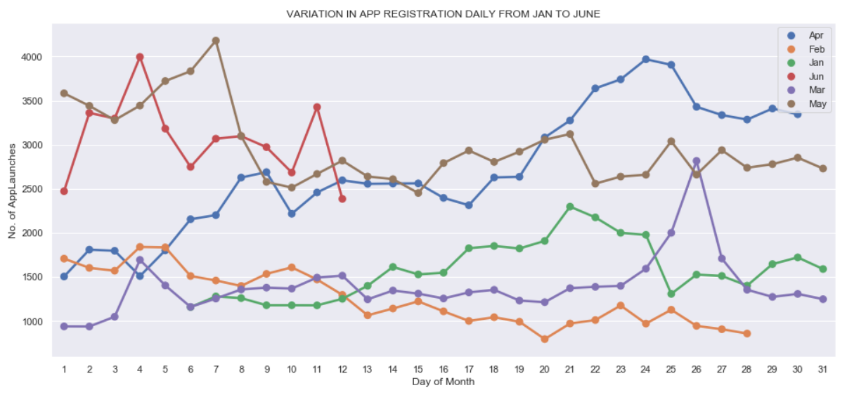
Data Exploration
Registration (Distribution Graphs)

Slide 8
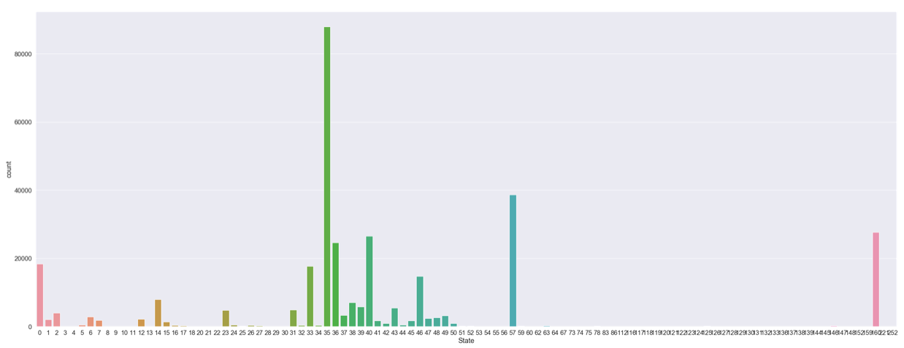
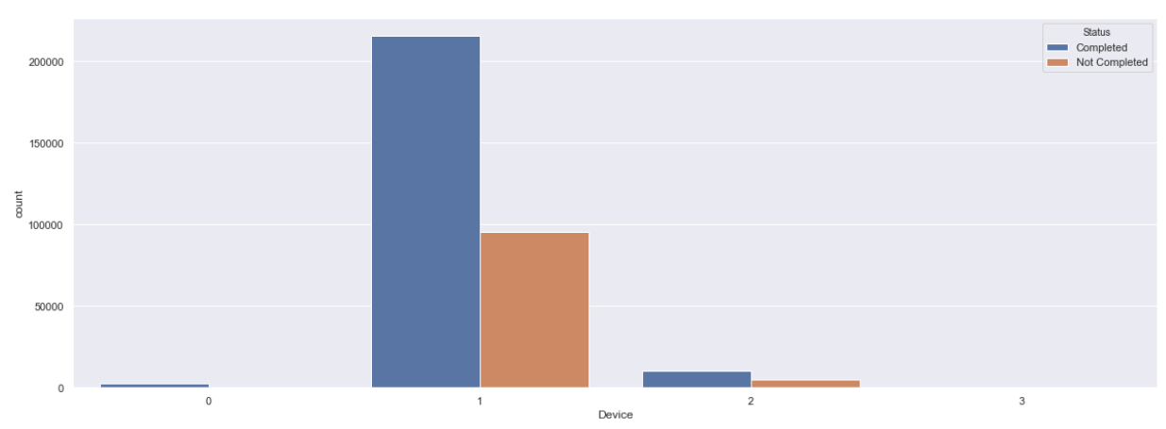
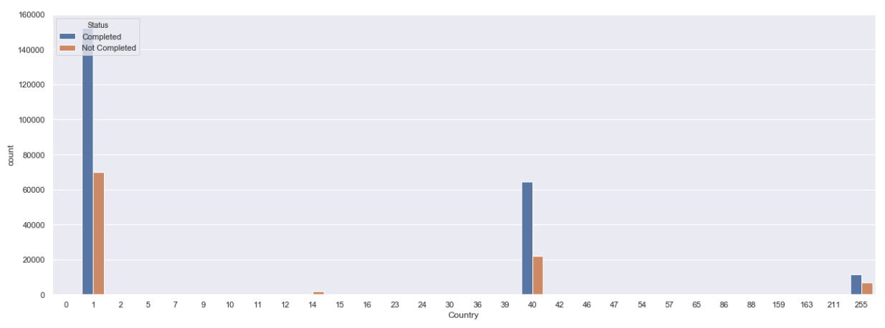
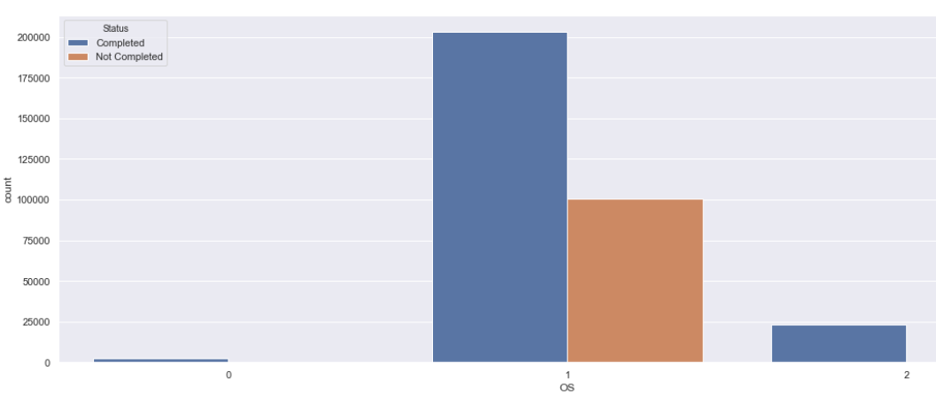
Data Exploration
Registration (Distribution Graphs)

Slide 9
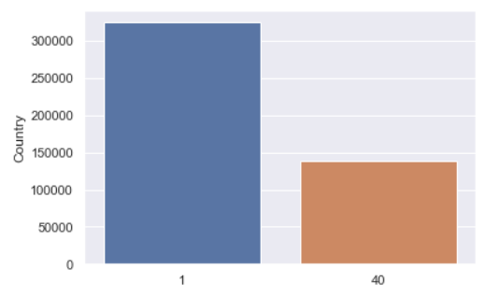
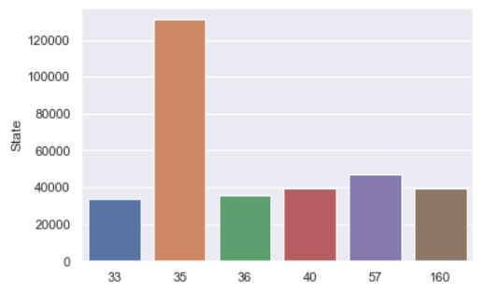
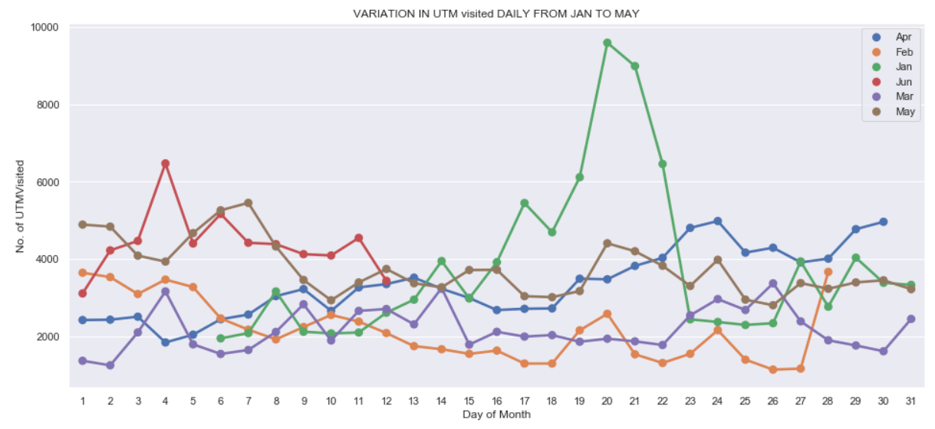
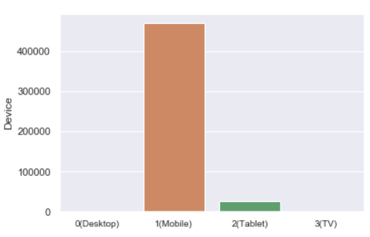
Data Exploration
UTMVisited (Distribution Graphs)

Slide 10
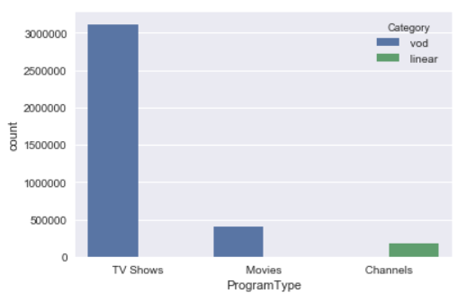
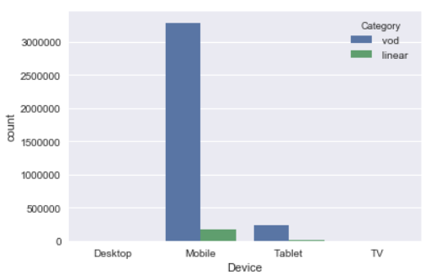
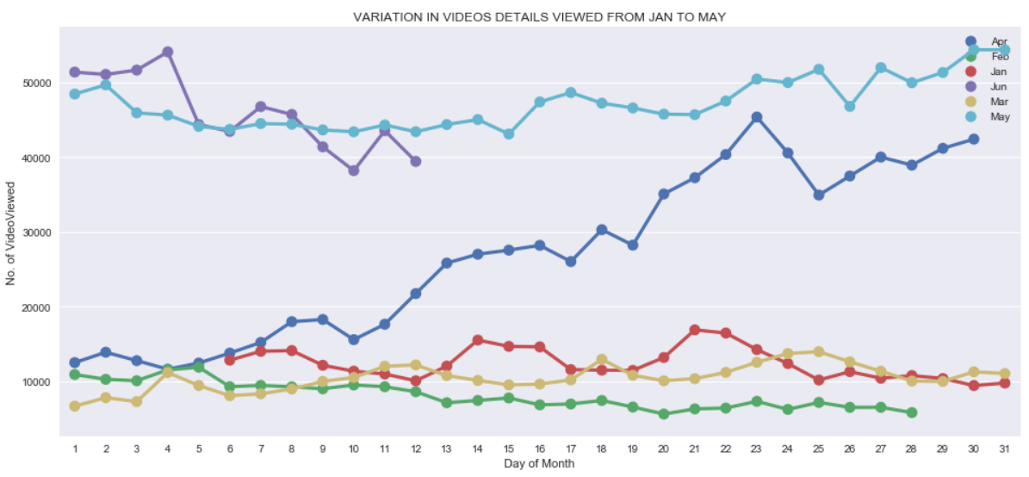
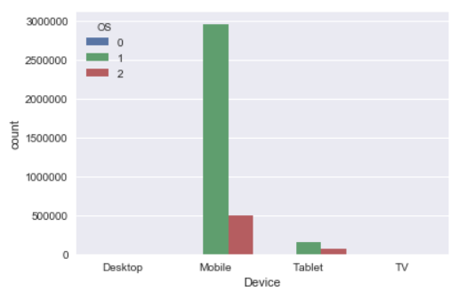
Data Exploration
VideoDetails (Distribution Graphs)

Slide 11
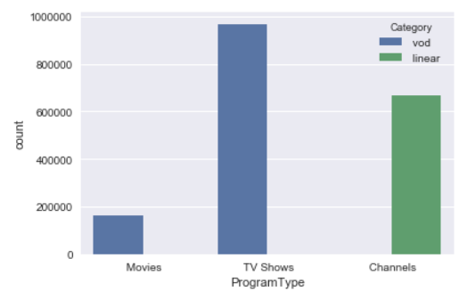
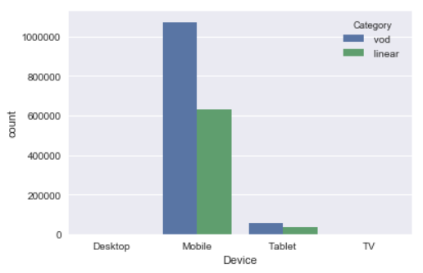
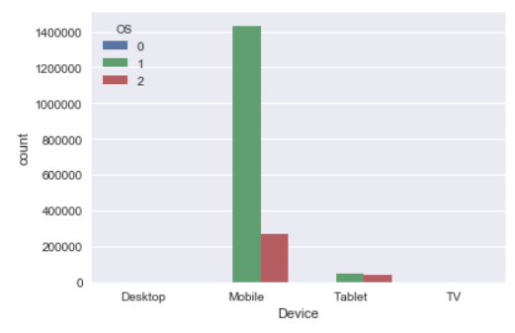
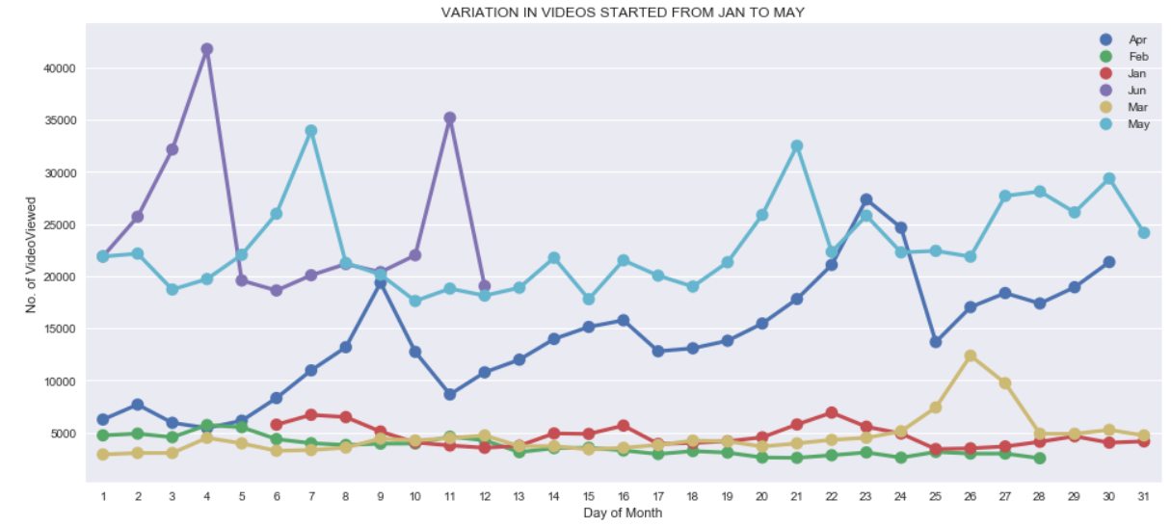
Data Exploration
VideoStarted (Distribution Graphs)

Slide 12
Most frequent User ID
User Id | Count
c519adb3903b3d83c46dcf05a9db441a | 1117656
484a57d4828cc3102113d745d43bafb9 | 490560
6bfd2ce12162d39c635b9df4b42c874a | 343147
befe5a9cd11684824f9763a9fc755075 | 225432
1dd0f1306405d9560dd100982c04556d | 225348

Slide 13
Most Frequent watched Video
Video Id | Count
2dd067e7a439ac5a433bb7aa7eec6b7b | 1580239
ef2f8cc077424405c8d09031ad76ef92 | 768211
e6ea7e407888ec088e91bafe475c91d0 | 653858
d5b0a8692cbbe447fd9014382047ad66 | 613226
dc9fe110cd1b581f107da6cba56bb95d | 562665

Slide 14
Variable Description
Variables
User Id: Unique user identifier
Date : The date on which event is raised
Minute of the day: The minute of
that day on which event was raised
Second: The second of the minute on which event was raised.
Country: Country Id
State: State Id of a Country
OS:OS of the device
Device: Type of device
Status-Status of Registration
Genre: The genre of the vedio
Program Type : Records of type-TV Shows or Movie
Category: Records the category (VOD)
Video Id: The Vedio name
Derived Variable
Time stamp
15-01-2017 17:04:04
Genre

Slide 15
Approach 1
App Installed
Video Started
Registration
User Id
Target Variable=1
If (User Id, Video Id) =(User Id, Video Id)
Target Variable=0
If (User Id, Video Id) ≠(User Id, Video Id)

Slide 16
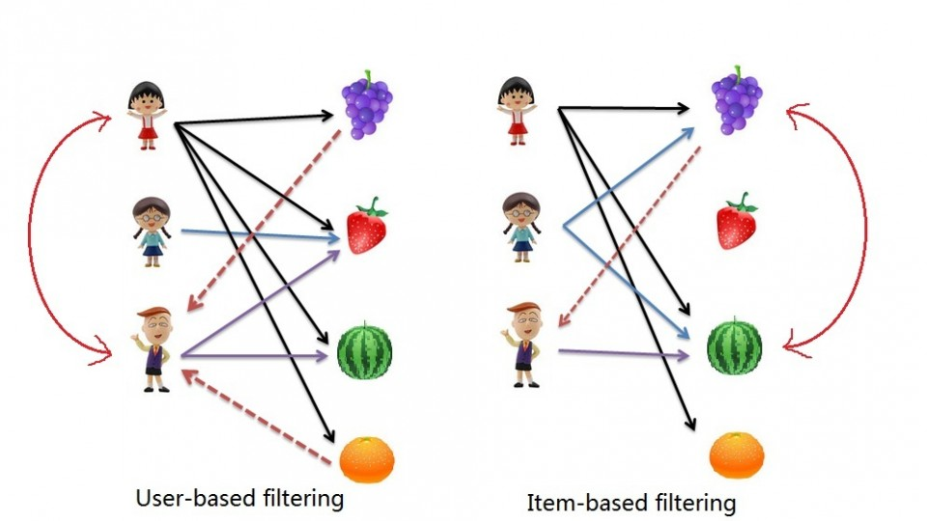
Collaborative Filtering

Slide 17
Analysis
Sample | 30 Lakhs
Correct | 3333
Incorrect | 14001
Accuracy | 19%

Slide 18
Approach 2- User Based Filtering
Sample Merged Data
Crosstab
Correlation on the basis of User Id
Sorting the data on the basis of highest correlation
Getting Top 5 user against each user
Compare the video among each user and recommend
Step 1
Step 2
Step 3
Step 4
Step 5
Step 6

Slide 19
Conclusion
Most of the user are using Mobile phones and their operating system is android
Most of the dataset is from Country 1 and genre is Drama
Accuracy on sample data is 19%

Slide 20
Thank You

